Slide 1
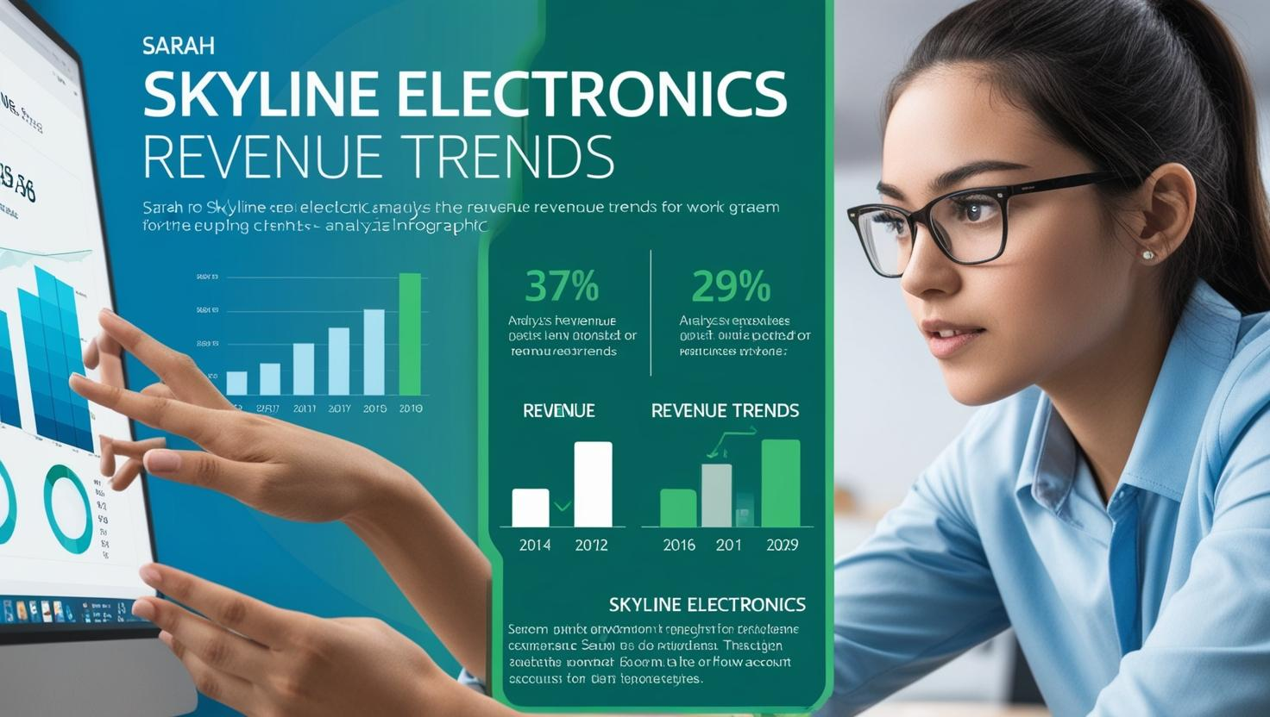

Slide 2


Slide 3

Lets Check Out the Data

Slide 4

Regional Revenue and Growth

Slide 5


Slide 6
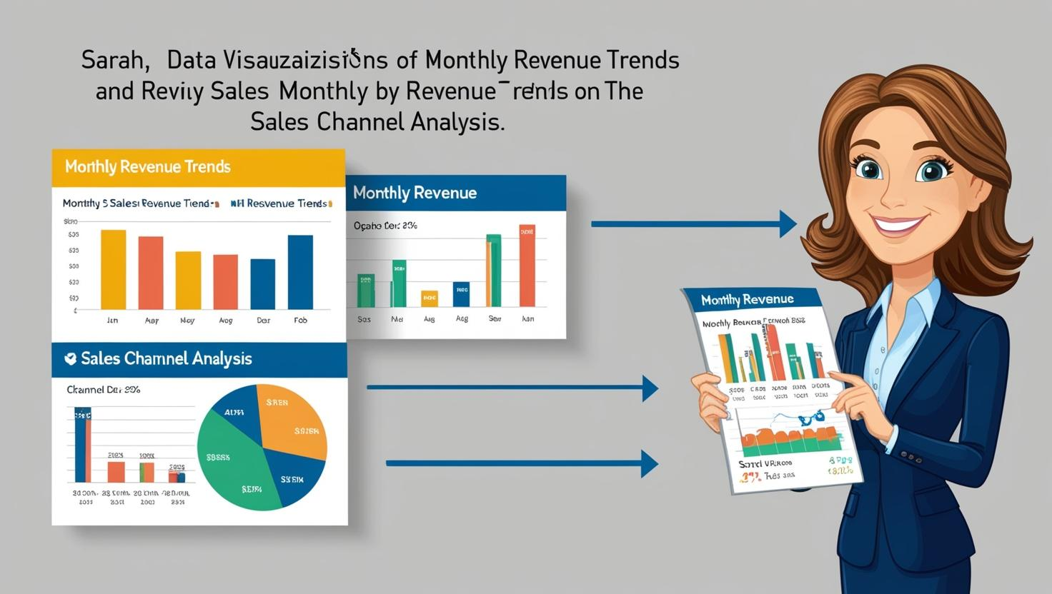
Monthly Revenue Trends and Sales Channel Analysis

Slide 7
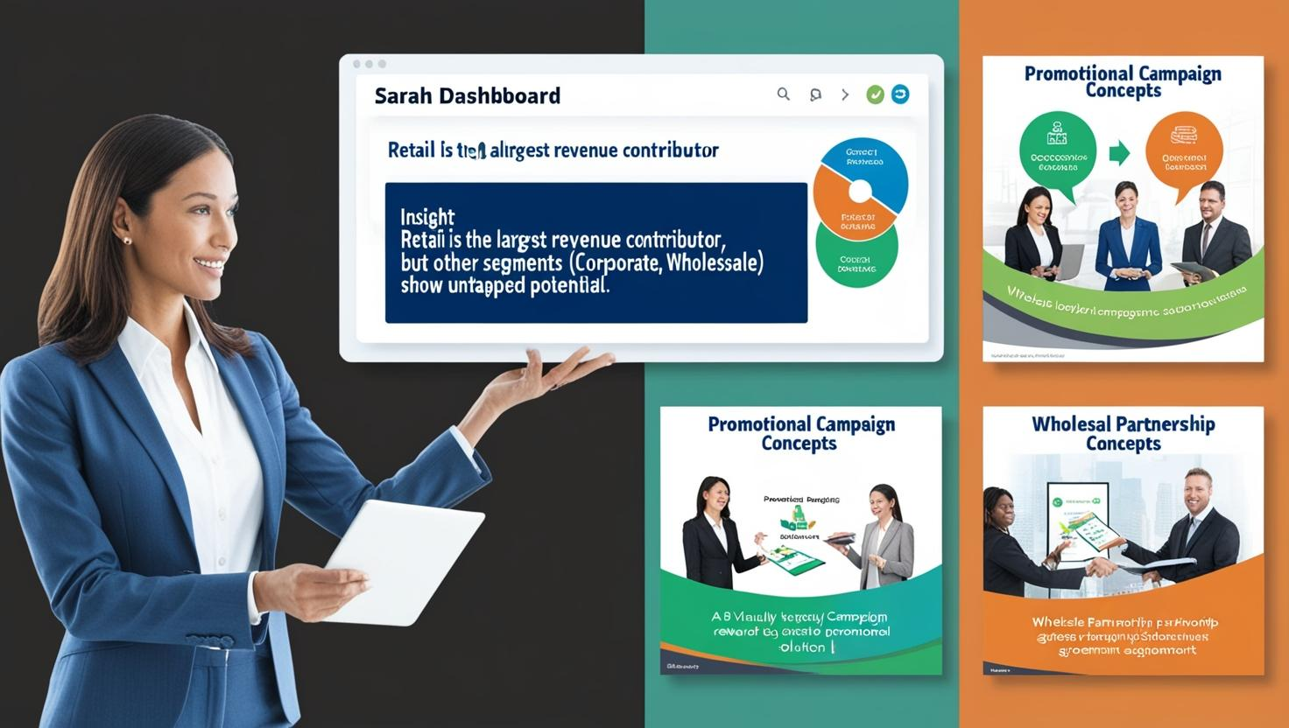

Slide 8
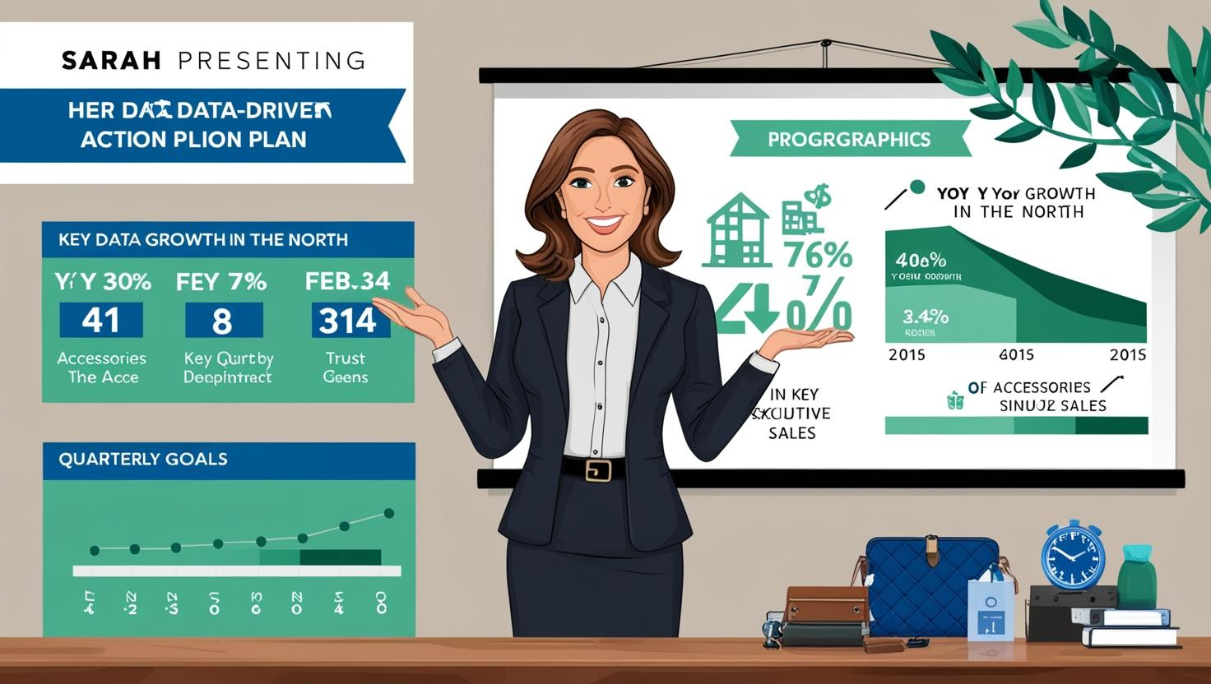


Slide 9

Thank You

